Slide 1


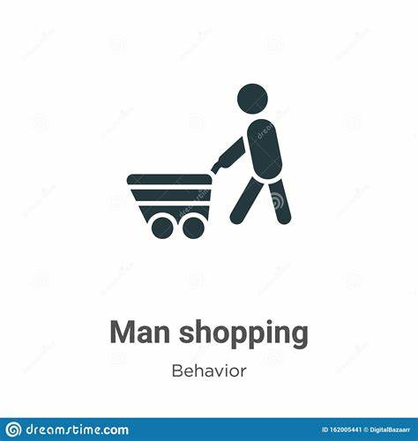





Amazon Consumer Behaviour analysis
Objective: To Discuss into the behavior patterns of new users on amazon and drive data-driven Recommendations to increase Sustainable growth.
Project Submitted By: Ankit Gangwar
ankitankit2072000@gmail.com
Agangwar14022023 (Ankit Gangwar) (github.com)

Slide 2

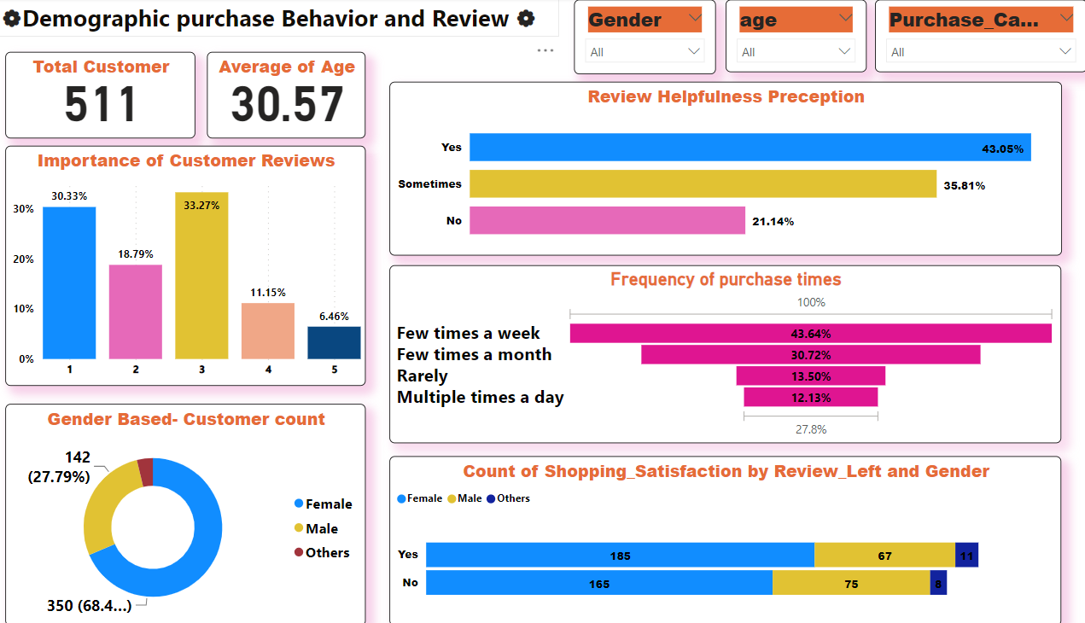


Slide 3
In this datasets we had 602 customers but after cleaning the data we have only 511 customers. There is avg age of total customers is 30.57.
Gender based Customers Count: there are 142 male,350 Female, and 19 others.
I take the card to filters by Gender ,Age, Purchase Category.
There is very importance of customer reviews by rating. Here I can see that mostly of customers(30.33%) go only on 1 rate and a few customers 6.46% go on 5 rate.
The frequency of purchase time is very less . There are 43.64% customers who purchase only few times a week
Recommendations: Encouraging reviews, maintaining their quality and recognizing engaged reviewers can enhance the overall customer experience and trust in the plateform.

Slide 4
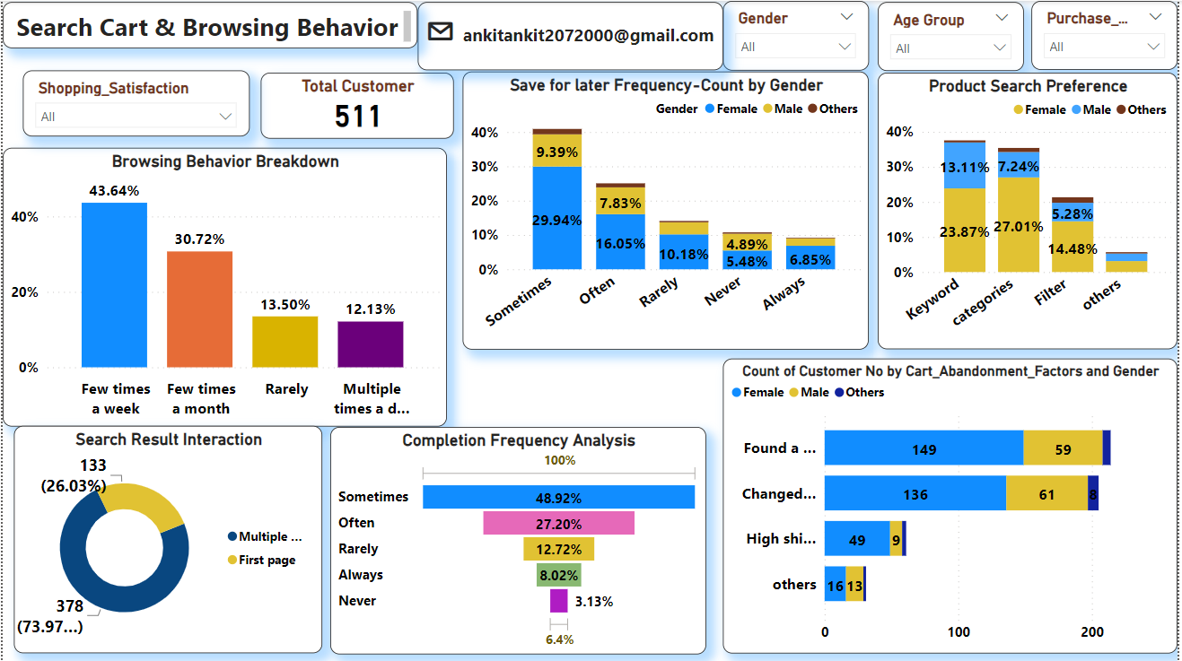

Slide 5
Insights:
The data reveals that a significant portion of customer browse the platform a few times a week, indicating a high level of engagement and interest in the products or service offered.
The product search preferences are evenly spilt between keyword- based search >23.87%-Female,13.11%-Male and 0.96%-Others, and category-based search >27.01%-Female,7.24%-Male , and 1.14%-Others.
There are mostly of customers (73.97%) who explore multiple pages for the product and a few number of customers is who can find only first page.
Recommendations:
Implement advanced search filters, Category products effective and use relevant categories to ensure that customers can easily find the products, They have looking for .

Slide 6
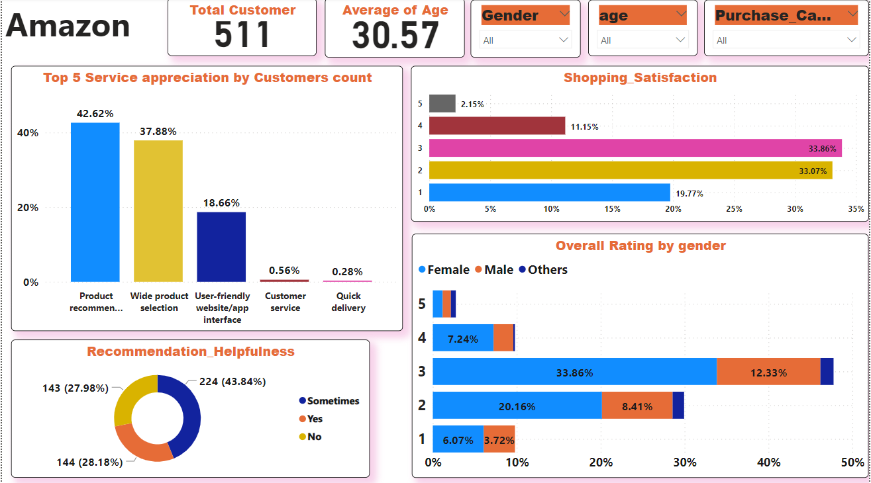

Slide 7
Insights:
In the shopping satisfaction we can see that 33.86% of customers rating their satisfaction as 3 and 33.07% rating it as 2.
that only 20% customers say "yes" to the frequency
If talk about the Recommendation_Helpfullness, that only 28.18% of customers say “Yes” to the frequency of personalized recommendations. While 43.84% of customers find recommendations “Sometimes”, and 27.98% of there are not satisfied with them.
Customers appreciate aspects like product recommendations , wide product selection, user-friendly Etc. The mostly of customers appreciate to product recommendations . While a few customers appreciate to quick delivery.
Recommendations:
Elevate product quality standards and accuracy to meet customer expectations, Regular quality checks and accurate product descriptions can significantly improve customer satisfaction

Slide 8


Regards,
Ankit Gangwar
Mob: 8941059541
Email: ankitankit2072000@gmail.com
Github:Agangwar14022023 (Ankit Gangwar) (github.com)

